Slide 1
5
第
部分
Q&A Session

Slide 2

05
Q&A Session
The Defination of Q&A Session
Questions are the interactive element of your presentation. Members of the audience have a chance to ask and learn more about those aspects of the subject in which they are most interested; Besides, you can take each one as an opportunity to support your argument and reinforce your message. It's also an opportunity to learn more about your audience and get to know that the subject being discussed very well; you and the sponsors receive valuable feedback information about audience reaction to the subject of the speech.
Questions and Answers Session is an important part in an international conference and is arranged for most of the meetings after presentation.
LOGO

Slide 3

05
Q&A Session
Questions for clarifying problems
I would be very glad if you could give definitions to the essential concept of A used in your presentation, for I am curious why you use them in this way in your report.
Questions showing special interests
I am very keen on your mentioning about the … How is it being carried out in your laboratory? What do you mean by …, and how do you think it can be tackled?
Questions raising different opinions
There are different types of questions to be asked:
Questions for clarifying problems
Questions showing special interests
Questions raising different opinions
Questions following up others’ questions
I agree with you about the approaches to solving this problem. But so far as the application aspect is concerned, I’m afraid I can’t say that I go along with you on that.
Questions following up others’ questions
Just now Professor Wang asked you … I’m also very interested in this subject. Would you please give us more examples to illustrate your ideas?
LOGO

Slide 4
05
Q&A Session
A good Q&A session-one that adds value to your presentation--reauires planning and thoughtful contributions from both the audience and the speaker
Q& A from the audience's perspective
Q& A from the speaker's perspective
Wait for the microphone, if there is one.
Pause for silence don't talk over a chattering
crowd.
Don't make excuses for yourself. This is tireso-me and unnecessary.
Don't address speakers by their first names. This always sounds affectedand inappropriately familiar, unless the atmosphereof the presentation is extremely casual.
Don't be longwinded. Careful planning will help you avoid being long-winded.
Speak up. Nothing's more frustrating to the audience than not being able tohear a question
It may be helpful for you to try to predict wha-t questions will be asked so that you can get
prepared in advance.
You may wish to accept questions at any time during your presentation, or to keep a time for questions after your presentation.
Normally, it's up to you, and you should
make it clear during the introduction.
Be polite with all questioners, even if the audience ask difficult questions. They are showing
interest in what you have said and they
deserve your attention.
TITLE
TITLE
TITLE
TITLE
TITLE
TITLE
LOGO

Slide 5

05
Q&A Session
Tips for Facilitating Question and Answer Sessions
Conclude smartly
Prepare a concluding statement to indicate the end of the question and answer session and to reinforce the main points of your presentation.
Anticipate likely questions and formulate possible responses before you present
01
04
Repeated practice
When rehearsing your speech, Practice your question and answer session, too, so that you will have practice articulating responses to likely questions.
Restate each question clearly
This helps you clarify the question, ensures that the entire audience hears the question, and gives you a moment to consider your response.
02
05
Establish a time limit
Inform your audience of the length when you begin the question and answer session. Be firm about cutting off questions when the predetermined time is up.
Be brief
Give simple answers to simple questions. When faced with a complicated or unwieldy question, answer concisely and then offer to meet the questioner later for further discussion.
03
06
LOGO

Slide 6
6
第
部分
Closing Speech

Slide 7
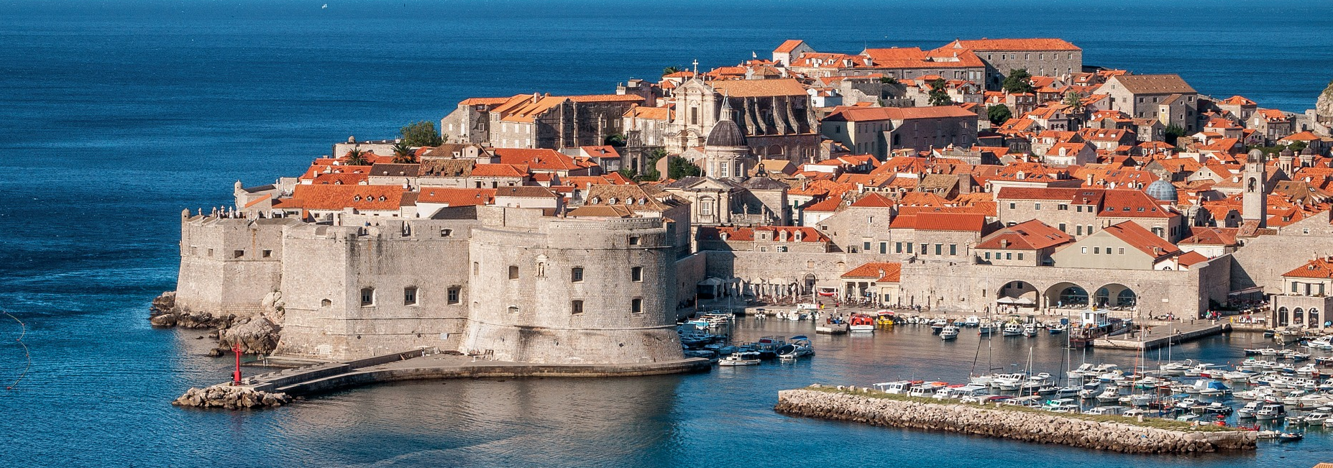
06
Closing Speech
At a closing session of an academic conference, the organizer or sponsor would deliver a closing speech, expressing thanks to all the people concerned, summarizing the accomplishments of the conference, commenting on the contributions of the conference, announcing the next conference, extending invitation to the participants and declaring the conference closed.
LOGO

Slide 8
06
Closing Speech
Paying compliments to the distinguished guests and all the participants
Expressing thanks to the participants, keynote speakers, chairpersons, distinguished guests, etc.
Congratulating on the success of the conference
Summarizing the contents and accomplishments of the conference
Inviting the participants to the next conference announced
Extending best wishes to the participants
LOGO

Slide 9
Closing Speech
06
Tips for closing speech
Delivering a good summary
You should recap the key points and provide a concise reminder of what you wanted the audience to remember after listening to your presentation. This is called the"sandwich effect, because you begin and end with the same idea, a main point that focuses on your presentation and draws the audience's attention throughout it.
LOGO

Slide 10
Closing Speech
06
Tips for closing speech
Presenting a short ending
You may deliver a message that logically comes out of the ideas developed in your presentation. It could bea comment, a lesson learned, a recommendation, and so on.fou may also deliver a message that is the realization of the ideas and opinions developedin your presentation. When quoting some famous lines of well-known figures, you should credit the sources of the quotes. The message should encourage the audience to think about or reflect on your presentation. If you want to suggest additional sources of information, you can give your audience some ways to expand on your ideas.
LOGO

Slide 11
Closing Speech
06
Tips for closing speech
Thanking the audience
The audience would appreciate it if their attendance is recognized even with just a simple expression of gratitude
LOGO

